Slide 1
1.1 Communication: History and Forms
Chapter 1 Introdction to Communication Studies Keimyung University
LEARNING OBJECTIVES
1. | Define communication
2. | Discuss the history of communication from ancient to modern times
3. | List the five forms of communication
1.2 The Communication Process
LEARNING OBJECTIVES
1. | Identify and define the components of the transmission model of communication
2. | Identify and define the components of the interaction model of communication
3. | Identify and define the components of the transaction model of communication

Slide 2
1.1 Communication: History and Forms
Chapter 1 Introdction to Communication Studies Keimyung University
LEARNING OBJECTIVES
1. | Define communication
2. | Discuss the history of communication from ancient to modern times
3. | List the five forms of communication

Slide 3
Chapter 1 Introdction to Communication Studies Keimyung University
1.1 Communication: History and Forms
1. | Define Communication
- | The process of generating meaning by sending and receiving verbal and nonverbal symbols and signs that are influenced by multiple contexts.

Slide 4
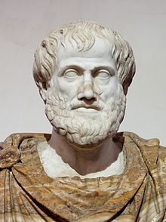
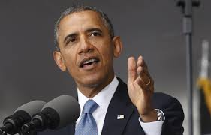
Chapter 1 Introdction to Communication Studies Keimyung University
1.1 Communication: History and Forms
2. | Discuss the history of communication from ancient to modern times
From Aristotle to Obama: A Brief History of Communication
384 BC – 322 BC
1961 AD -

Slide 5

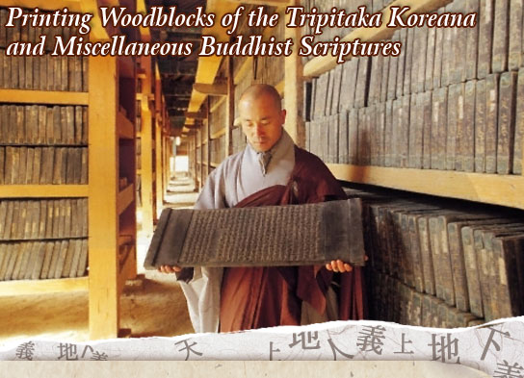
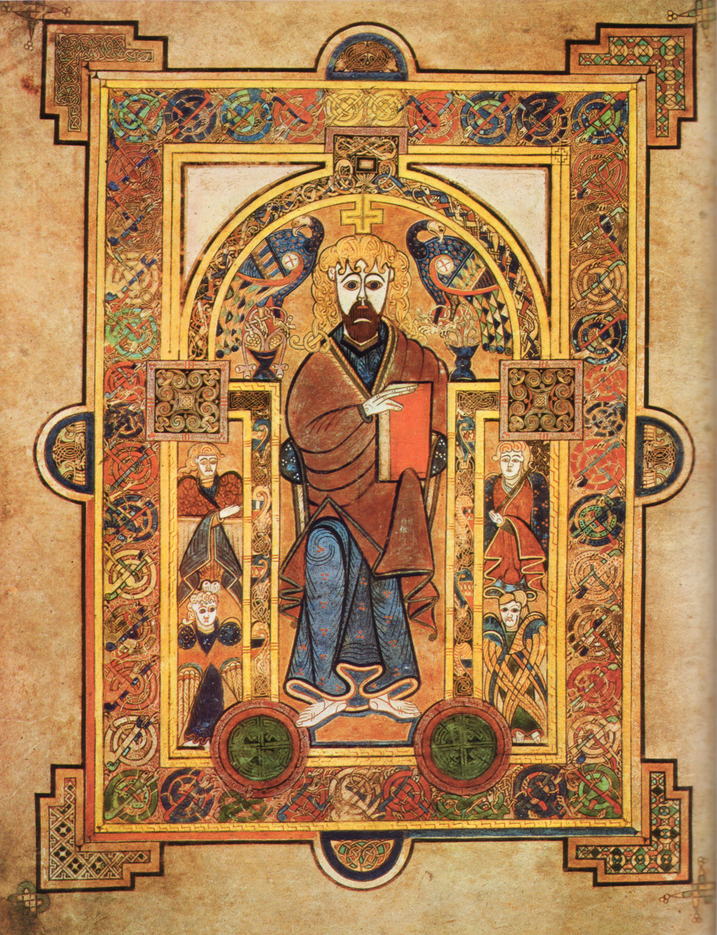
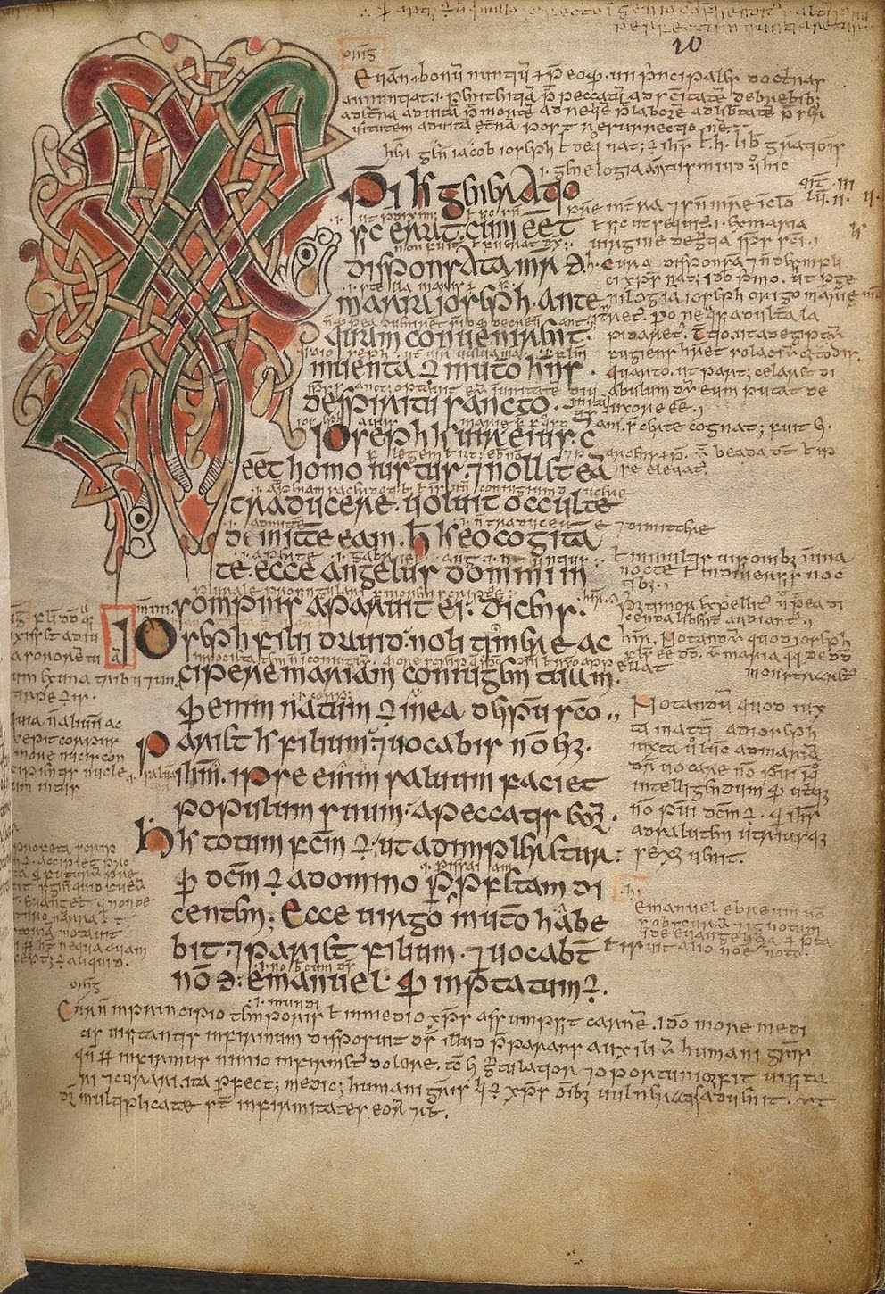
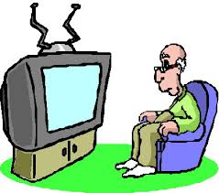
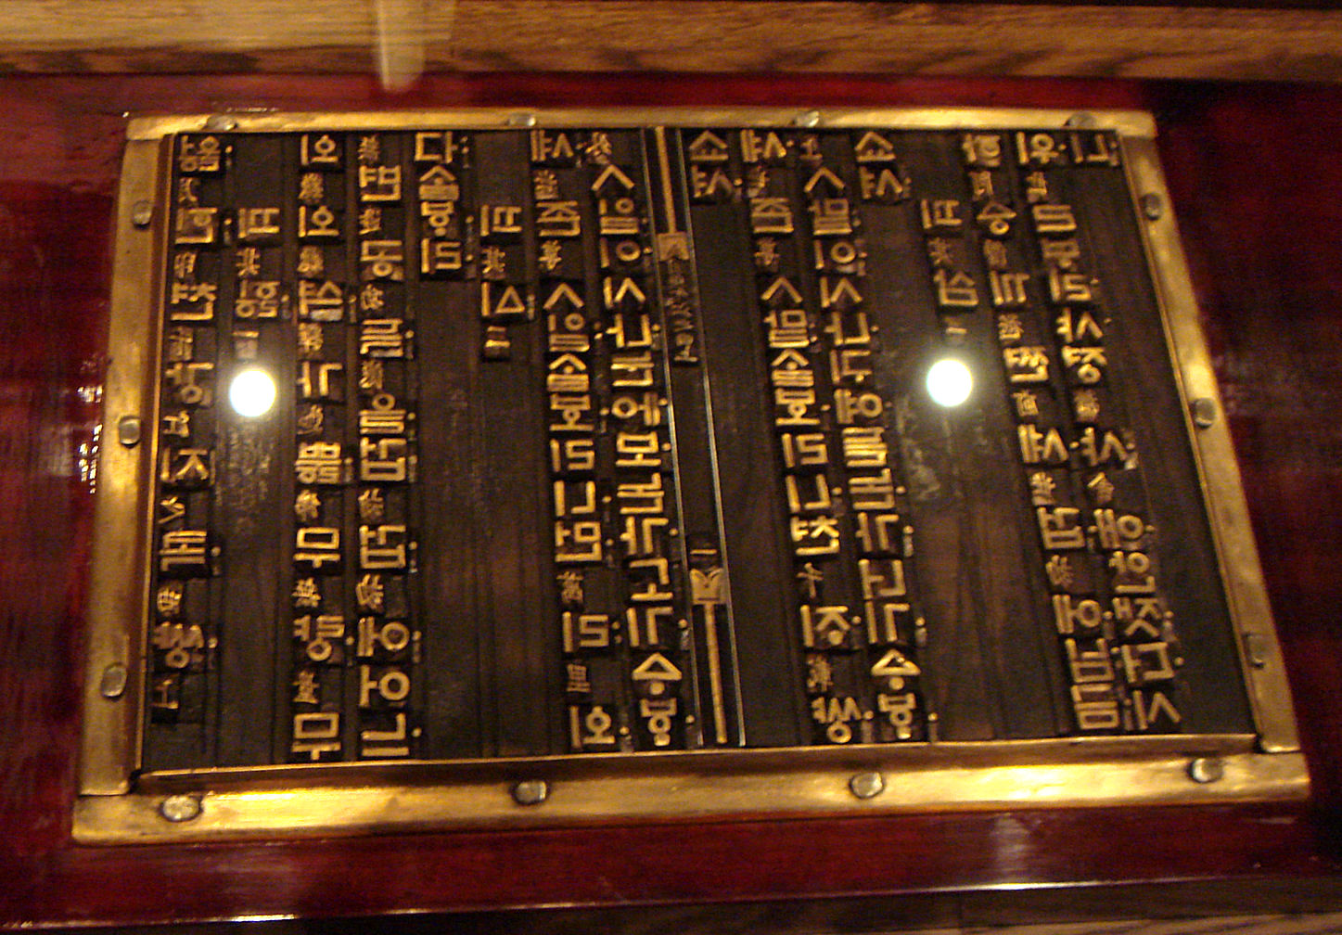
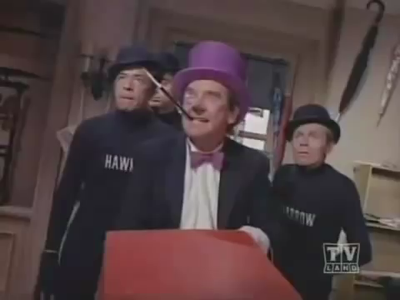
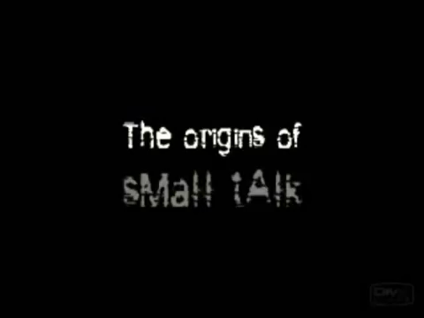
Chapter 1 Introdction to Communication Studies Keimyung University
1.1 Communication: History and Forms
2. | Discuss the history of communication from ancient to modern times
From Aristotle to Obama: A Brief History of Communication
Talking Era
180,000 BCE -3,500BCE
Manuscript Era
3,500 BCE - 1850
Print Era
1450-1850
Audio Visual Era
1850-1990
Internet Era
1990-
?

Slide 6
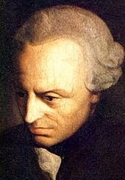
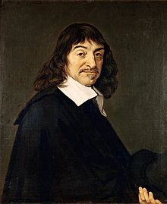
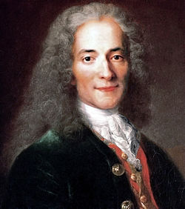
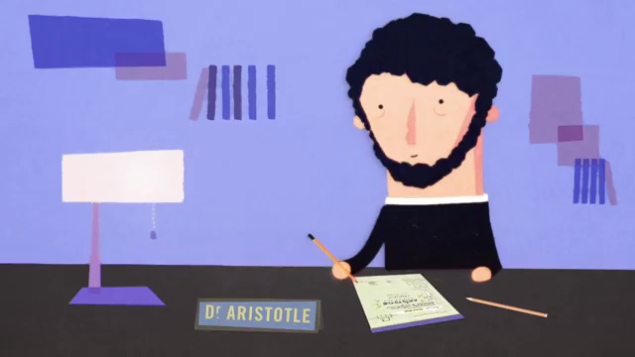
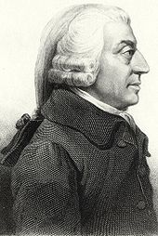
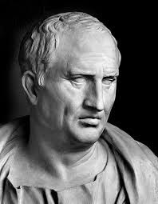
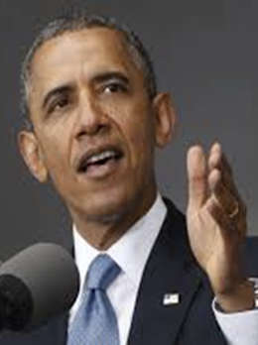

Chapter 1 Introdction to Communication Studies Keimyung University
1.1 Communication: History and Forms
2. | Discuss the history of communication from ancient to modern times
Cicero – 5 Canons (Principles) of Persuasion
Invention
Arrangement
Style
Memory
Delivery
From Aristotle to Obama: A Brief History of Communication
Aristotle (384 BC – 322 BC)
Cicero (106 BC - 43 BC)
The Age of Enlightenment
(1650s to the 1780s)
Obama (1961 AD -)
Rhetoric
Five Canons
Challenge
Communication

Slide 7
Chapter 1 Introdction to Communication Studies Keimyung University
1.1 Communication: History and Forms
3. | List the 5 forms of communication
1. Intrapersonal Communication
2. Interpersonal Communication
3. Group Communication
4. Public Communication
5. Mass Communication

Slide 8

Chapter 1 Introdction to Communication Studies Keimyung University
1.1 Communication: History and Forms
3. | List the 5 forms of communication
1. Intrapersonal Communication
Intrapersonal communication is communication with ourselves that takes place in our heads.

Slide 9
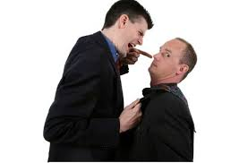
Chapter 1 Introdction to Communication Studies Keimyung University
1.1 Communication: History and Forms
3. | List the 5 forms of communication
2. Interpersonal Communication
Interpersonal communication is communication between people whose lives mutually influence one another.

Slide 10

Chapter 1 Introdction to Communication Studies Keimyung University
1.1 Communication: History and Forms
3. | List the 5 forms of communication
3. Group Communication
Group communication is communication among three or more people interacting to achieve a shared goal.

Slide 11

Chapter 1 Introdction to Communication Studies Keimyung University
1.1 Communication: History and Forms
3. | List the 5 forms of communication
4. Public Communication
Public communication is a sender-focused form of communication in which one person is typically responsible for conveying information to an audience.

Slide 12
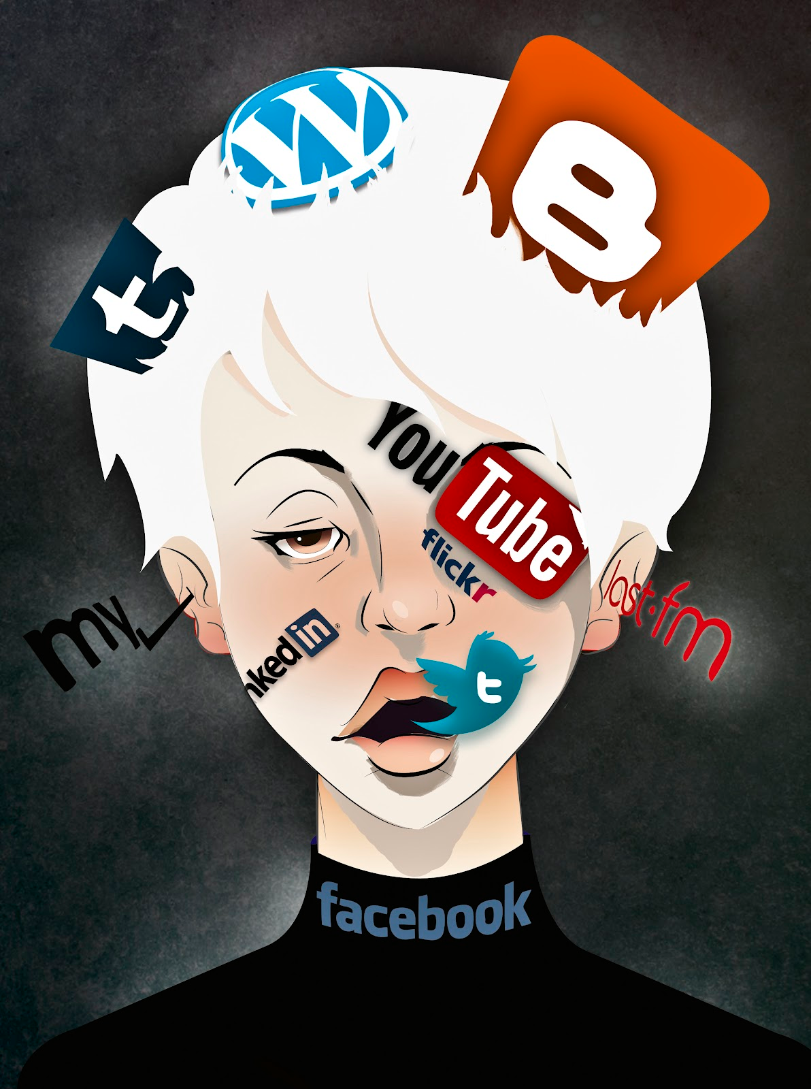
Chapter 1 Introdction to Communication Studies Keimyung University
1.1 Communication: History and Forms
3. | List the 5 forms of communication
5. Mass Communication
Mass communication is when messages are transmitted to many people through print or electronic media.

Slide 13
1.2 The Communication Process
Chapter 1 Introdction to Communication Studies Keimyung University
LEARNING OBJECTIVES
1. | Identify and define the components of the transmission model of communication
2. | Identify and define the components of the interaction model of communication
3. | Identify and define the components of the transaction model of communication

Slide 14
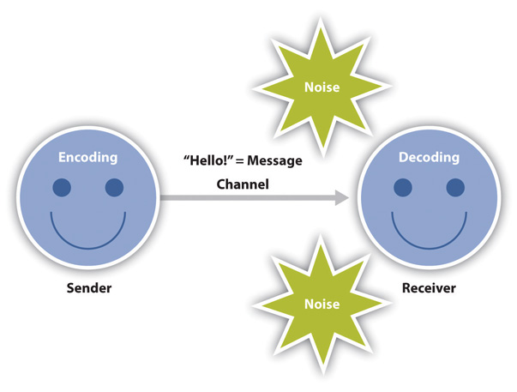
Chapter 1 Introdction to Communication Studies Keimyung University
1.2 The Communication Process
1. | The Transmission Model of Communication
Environmental Noise
Semantic Noise

Slide 15
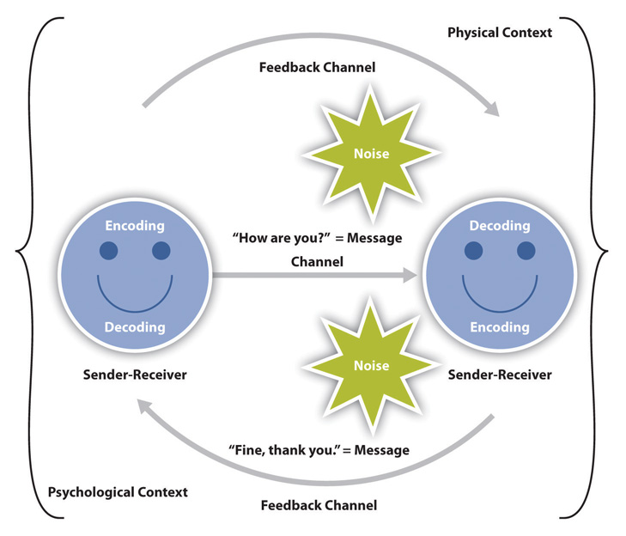
Chapter 1 Introdction to Communication Studies Keimyung University
1.2 The Communication Process
2. | The Interaction Model of Communication

Slide 16
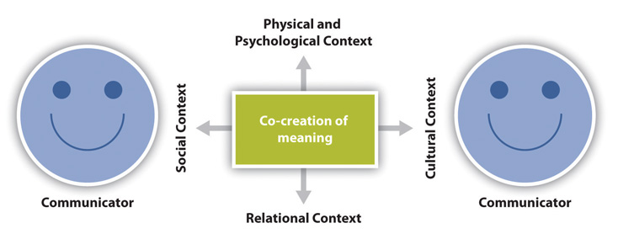
Chapter 1 Introdction to Communication Studies Keimyung University
1.2 The Communication Process
3. | The Transaction Model of Communication

