Slide 1
TESOL Writing
November 19th and 20th

Slide 2
TESOL Writing
Let’s start…
On the 2 pieces of paper you are given, please write 2 questions you would like to ask me.

Slide 3
TESOL Writing - Introductions
Activity focus: Introductions, expressing likes/dislikes/interests and using conjunctions
Carlos:
-BE INTO Jazz (o), rock and roll (x)
Carlos is into jazz, but he isn’t into rock and roll.
-ENJOY PLAYING Football (o), tennis (o)
Carlos enjoys playing football and tennis.
-LIKE Pizza (o), fish (x), grapes (o)
Carlos likes pizza and grapes, but he doesn’t like fish.
-BE INTERESTED IN Talk shows (x), dramas (x)
Carlos isn’t interested in talk shows or dramas.

Slide 4
TESOL Writing - Introductions
Interview your partner and complete the following
(write O if they agree or X if they do not):
LIKE Cabbage ( ), carrots ( ), onions ( )
BE INTERESTED IN cars ( ), motorcycles ( ), fashion ( )
ENJOY DRINKING beer ( ), soju ( ), whiskey ( )
BE INTO rock ( ), pop ( ), hip-hop ( )
LIKE TO PLAY Volleyball ( ), hockey ( )
LIKE Beef ( ), live octopus ( )
BE INTO Na Hoon Ah ( ), In Soon E ( ), Kim Gun Mo ( )

Slide 5
TESOL Writing - Introductions
Quick Review
When do we use capitalization?
Countable or uncountable nouns?
Commas?
Conjunctions?

Slide 6
TESOL Writing - Introductions
With your partner brainstorm 3 things for each category and write them in the blanks.
Like (sports) __________, ____________, ___________,
When you finish, you will interview different classmates, ask them about the sports chosen and write a sentence.
___________________________________________________

Slide 7
Paragraph Development – Process and
Product Approach

Slide 8
Paragraph Development
What are some of the elements of a paragraph?
-Unity
-Coherence and Cohesion
-Topic Sentence
-Adequate Development
Unity
The entire paragraph should concern itself with a single focus. If it
begins with a one focus or major point of discussion, it should not end
with another or wander within different ideas.

Slide 9
Paragraph Development
Coherence and Cohesion
Coherence and Cohesion are the traits that make the paragraph easily understandable to a reader. You can
help create coherence in your paragraphs by creating logical bridges and verbal bridges. Cohesion can be
achieved by using reference words (pronouns) and synonyms instead of repeating the same word.
Logical bridges
• The same idea of a topic is carried over from sentence to sentence
• Successive sentences can be constructed in parallel form
Verbal bridges
• Key words can be repeated in several sentences
• Synonymous words can be repeated in several sentences
• Pronouns can refer to nouns in previous sentences
• Transition words can be used to link ideas from different sentences

Slide 10
Paragraph Development
Paragraph Part Purpose of the Paragraph Part
1. The topic sentence states the main point. The topic sentence is often the first sentence in the paragraph.
2. The body supports (shows, explains or proves) the main point. It usually contains three to six support sentences, which present facts and details that develop the main point.
3. The concluding sentence reminds readers of the main point and often makes an observation.

Slide 11
Paragraph Development
Read the paragraph that follows. Standard parts of the paragraph are labeled (a,b,c):
Asking your boss for a raise doesn't have to be painful if you plan the
conversation well (a). First, think about how you will introduce the
subject when you talk with your boss. Then make a list of reasons why
you deserve the raise. Be prepared to give specific examples of your
achievements. When your plan is ready, make an appointment to meet
with your boss (b). Your plan will allow you to be confident and will
increase your chance of success (c).
a= topic sentence
b= body, made up of support sentences
c= concluding sentence

Slide 12
Paragraph Development
Useful Transition Words Be Careful! Many of these require context to be taught and used correctly!
Signaling words
1. Time/order (at first, eventually, finally, first, firstly, in the end, in the first place, in the second place, lastly, later, next, second, secondly, to begin with)
2. Comparison/similar ideas (in comparison, in the same way, similarly)
3. Contrast/opposite ideas (but, despite, in spite of, even so, however, in contrast, in spite of this, nevertheless, on the contrary, on the other hand, still, whereas, yet)
4. Cause and effect (accordingly, as a consequence, as a result, because, because of this, consequently, for this reason, hence, in consequence, in order to, owing to this, since, so, so that, therefore, thus)
5. Examples (for example, for instance, such as, thus, as follows)
6 Generalization (as a rule, for the most part, generally, in general, normally, on the whole, in most cases, usually)
7. Stating the obvious (after all, as one might expect, clearly, it goes without saying, naturally, obviously, of course, surely)

Slide 13
Paragraph Development
Signaling words - continued
8. Attitude (admittedly, certainly, fortunately, luckily, oddly enough, strangely enough, undoubtedly, unfortunately)
9. Summary/conclusion (finally, in brief, in conclusion, in short, overall, so, then, to conclude, to sum up)
10. Explanation/equivalence (in other words, namely, or rather, that is to say, this means, to be more precise, to put it another way)
11. Addition (apart from this, as well as, besides, furthermore, in addition, moreover, nor, not only...but also, too, what is more)
12. Condition (in that case, then)
13. Support (actually, as a matter of fact, in fact, indeed)
14. Contradiction (actually, as a matter of fact, in fact)
15. Emphasis (chiefly, especially, in detail, in particular, mainly, notably, particularly)

Slide 14
Paragraph Development
Complete the lines with information that fits with the given signal words.
My parents were very ____________________________________________________.
For example, ____________________________________________________.
In fact, ____________________________________________________.
As a result, ____________________________________________________.

Slide 15
Paragraph Development
Complete the following in your workbooks.
______________________ is a big problem in Korea.
Namely, ____________________________________________.
Consequently, ________________________________________.
Despite this,__________________________________________.

Slide 16
Paragraph Development
Complete the following in your workbooks.
I do not like _____________________________________________.
To be more precise _______________________________________.
Admittedly, _____________________________________________.
However, ______________________________________________.
*Read the 3 ‘paragraphs’ with your partner – are they logical?
*Look back at the paragraph you wrote – are there any signal words you could use to make it flow better?

Slide 17
Paragraph Development
Choose one of the given topic sentences, and write one paragraph on that topic.
Topic Sentence 1: Having a first child is difficult because of the significant adjustments in your life.
Topic Sentence 2: It is important to be ready before buying a house.

Slide 18
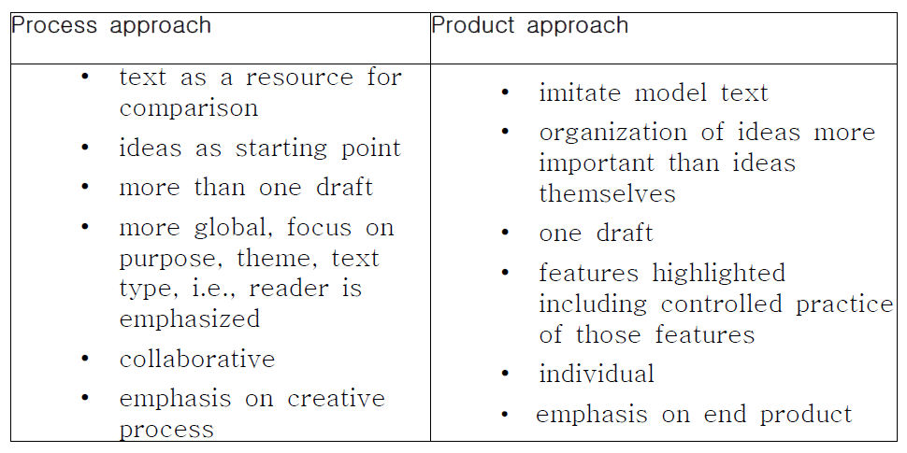
Process Approach and Product Approach

Slide 19
Process Approach
"[Writing] is messy, recursive, convoluted, and uneven. Writers
write, plan, revise, anticipate, and review throughout the writing
process, moving back and forth among the different operations
involved in writing without any apparent plan. (Hairston 1982: 85)"

Slide 20
Process Approach
Pre-writing/Idea Generation and Organization
Brainstorming
Clustering
Freewriting
Looping
The Journalists' Questions

Slide 21
Process Approach
Choose one pre-writing method to generate ideas for the topic sentence you have previously written on, and write one paragraph on that topic.
Topic Sentence 1: Having a first child is difficult because of the significant adjustments in your life.
Topic Sentence 2: It is important to be ready before buying a house.
After you have finished your pre-writing exercise, draft your first copy.
Then, using the following writing checklist, first perform a self check and have your partner look at your writing too.
Revise, based on your own and partner’s feedback, and then write a second draft (teacher will collect and give feedback for tomorrow’s class).

Slide 22
Process Approach
Simplified Feedback Symbol Guide
C – capital letter
WR – wrong word
SV – subject verb don’t match
WO - Change word order
X – remove word
V – add word
P – plural
G – grammar mistake
SP - spelling

Slide 23
Product Approach
This is a traditional approach, in which students are encouraged to mimic a model text, which is usually presented and analyzed at an early stage. A model for such an approach is outlined below:
1. Model texts are read, and then features of the genre are highlighted.
2. This consists of controlled practice of the highlighted features, usually in isolation.
3. Organization of ideas.
4. Students choose from a choice of comparable writing tasks. Individually, they use the skills, structures and vocabulary they have been taught to produce the product; to show what they can do as fluent and competent users of the language.

Slide 24
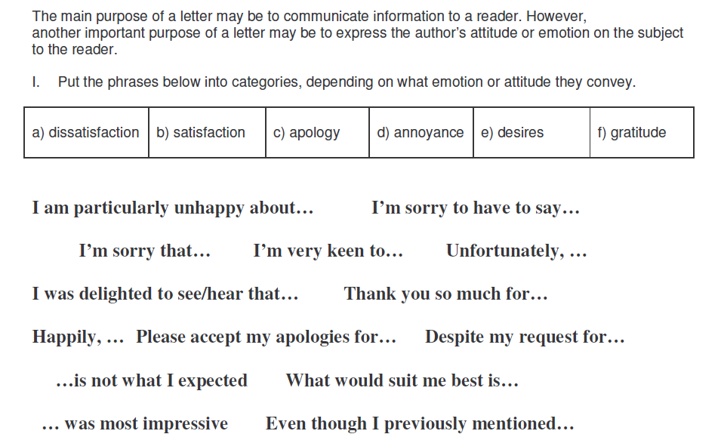
Product Approach - Sample

Slide 25
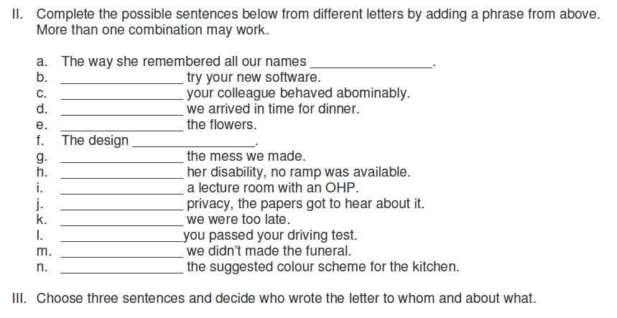
Product Approach - Sample

Slide 26
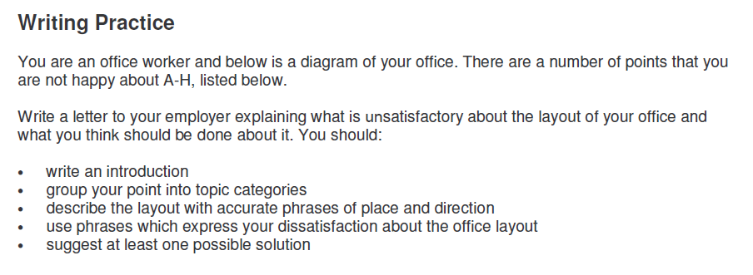
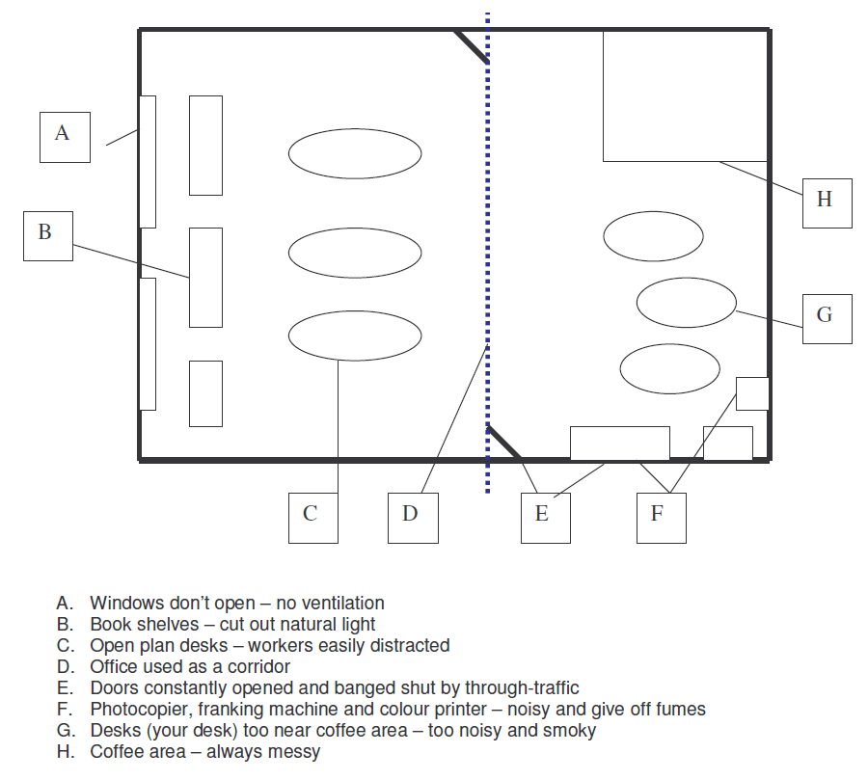
Product Approach - Sample

Slide 27
Product Approach
Using the examples and sample letter format, construct your own letter of complaint to your employer.

Slide 28
Fluency vs. Accuracy?
With your group brainstorm some differences between the two.

Slide 29
Fluency-focused Activities
Morning session

Slide 30
Fluency-focused Activities
Types of fluency-focused activities:
- Poems
- Writing to each other
- Using pictures
- Using music
- Dialogue journals

Slide 31
Fluency-focused Activities
Poems
-Poems allows students to write powerful messages in a short space.
-Students can play with vocabulary and grammar
-Pre-established patterns give students support and focus

Slide 32
Fluency-focused Activities
Acrostic/Alphabet poems
-good for introducing a topic
-teacher can request certain grammatical pattern
Example:
People are walking, talking, and napping (present continuous)
Angry children are fighting
Rollerbladers are skating swiftly
Kindergarten students are traveling in long lines
Senior citizens are playing g0-stop

Slide 33
Fluency-focused Activities
Create your own poem and share with your partner.
B______________________________________
E______________________________________
A______________________________________
C______________________________________
H______________________________________

Slide 34
Fluency-focused Activities
Stem/Frame Poems
I enjoy ___________ because____________
I enjoy ___________ because____________

Slide 35
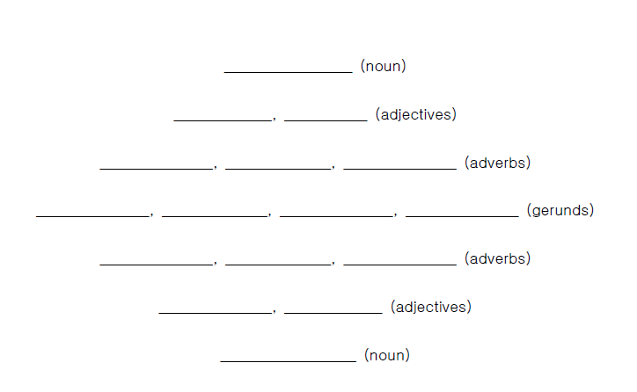
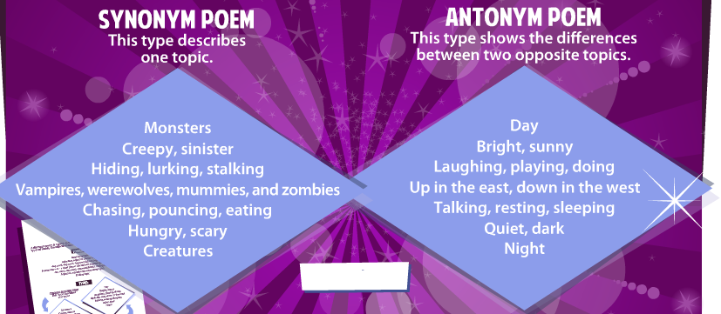
Fluency-focused Activities
Diamante

Slide 36
Fluency-focused Activities
Metaphor Generators
To ________________
You are ______________________(food)
You are ______________________(weather)
You are ______________________(animal)
You are ______________________(plant)
To Kai,
You are a box of Ddang Ddang chicken,
You are a sunny day,
You are an impish chimpanzee,
You are a pure lotus flower.

Slide 37
Fluency-focused Activities
Writing to Each Other
Pen pal/ Key pal
-Teachers organize and monitor students’ correspondence with actual students from other countries.
Email Dialogue Sheet
-Students write short letters to each other on paper in the form of email.

Slide 38


Fluency-focused Activities
Kakao Chat

Slide 39
Fluency-focused Activities
Letters Back and Forth
- Read an article to the students
-Students then write their opinion of the article
-Students then exchange letters and write about why they agree
or disagree with each other’s letters
Letters of Inquiry
- Students write a letter requesting some kind of information,
students then reply to each other’s letters
Advice Column
-Students write a letter describing a problem they have, students
then exchange letters and reply with advice

Slide 40
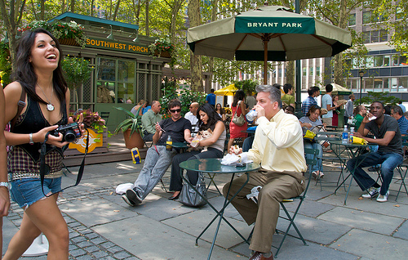
Fluency-focused Activities
Using Pictures
Describing Pictures
-Give students a picture and a time limit to write down as much as they can. Provide vocabulary support if needed.
Multiple Objects
-Give students a variety of pictures but have them describe only one of them. Students exchange papers and try to identify the picture that they described.

Slide 41
Fluency-focused Activities
Postcards
-Give students a postcard scene and have them write a postcard.
Portraits
-Students look at a portrait and then write a letter to that person asking many questions. Other students will respond to that letter as the person in the portrait.
-Students could also assume the identity of the person in the portrait and write a diary entry.

Slide 42
Fluency-focused Activities
Story Tasks
-Students look at a dramatic picture and write about what happens next.
-Students are given pictures of objects (a ball, a fire place, a watch, an airplane) and write story that somehow connects them.
-Students are given a sequence of pictures that show a story and then write the story.
-Students are given a picture with a headline then write a story that goes with them.
Complete the sentence
My favorite time of day is….
I really can't stand…
Yesterday was really…

Slide 43
Story Task

Slide 44
Fluency-focused Activities
Daily Weather Forecast
Students report on how they feel that day like a weather report.
Using Music
-Listen to some music and write down the words that come to mind
-Listen to music and write down what the composer was trying to describe or how the composer felt that day
-Imagine that the music is for a movie. Students write about the scene that goes with music.
-Give students the first line of a story:
"The man turned and looked at the woman."
Students continue the story by writing what happens next.
Then students turn their paper over and write the same sentence, but listen to a different piece of music. This will inspire a different story.
Partners can read to each other and try to guess which music inspired each story.

Slide 45
Fluency-focused Activities
Using Music
Write ‘Susie looked out the window’ at the top of your page.
  You will hear one piece of music and write what you think happens next.
  https://www.youtube.com/watch?v=DH8StTUCQNY
Now, turn your paper over and write the same sentence.
  You will hear another piece of music and write what you think happens next.
  https://www.youtube.com/watch?v=rlWRiZo7T4I

Slide 46
Fluency-focused Activities
Dialogue Journals
-Written conversations in which a learner and teacher (or other writing partner) communicate regularly.
-Learners write as much as they choose on a wide range of topics and in a variety of genres and styles.
-The teacher writes back regularly, responding to questions and comments, introducing new topics, or asking questions.
-The teacher is primarily a participant in an ongoing, written conversation with the learner rather than an evaluator who corrects or comments on the quality of the learner's writing.
-Topics for or types of writing may be specified to enhance the curriculum, and some correction may be given by the teacher, but the primary goal of the writing is communication.

Slide 47
Quick Review
Before we begin, look back over the completed activities from the morning session and rate each one as:
1) very useful
2) somewhat useful
3) not so useful
4) not useful
5) impossible
Now, compare with your partner and discuss any modifications that would make them more suitable for your own learners.

Slide 48
Accuracy-focused Activities
Afternoon session

Slide 49
Accuracy-focused Activities
What are some benefits of accuracy-focused writing?

Slide 50
Accuracy-focused Activities
Types of accuracy-focused activities:
- Copying
- Structured writing
- Cooperative writing

Slide 51
Accuracy-focused Activities
Improving Accuracy - Copying
Why copy?
-improves concentration and attention to detail
-improves spelling
-practices handwriting
-reinforces grammar, punctuation, and capitalization rules
"Class, you must write each word 5 times"
  How can we make it interesting and meaningful?

Slide 52
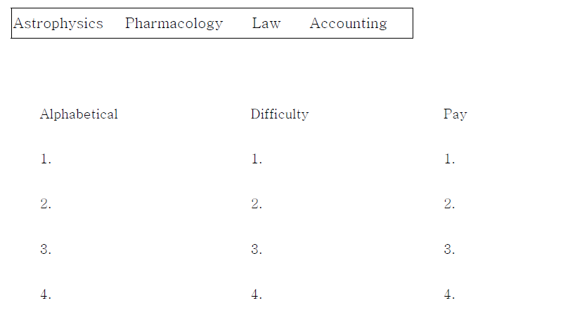
Accuracy-focused Activities
Disguised Copying
-Have students rewrite the words in different kinds of order.
1. alphabetical order
2. easiest to hardest
3. ____________________________
4. ____________________________
5. ____________________________

Slide 53
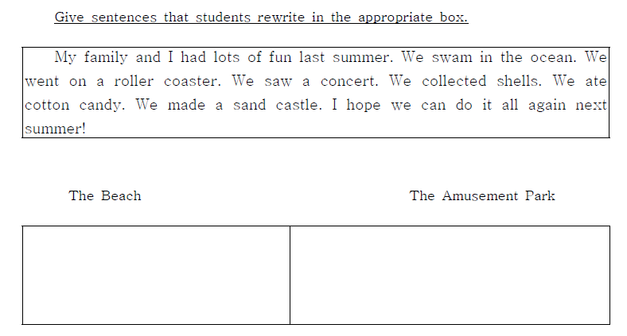
Accuracy-focused Activities

Slide 54
Accuracy-focused Activities
Students rewrite certain aspects of the text.
An old-fashioned desk with brass drawer handles waits patiently for me in front of the window, its wood full of nicks from many careless moves and two once-teething puppies. May I introduce you to Ralph, my friendly computer, who sits on top of the desk? When I turn him on, he'll crackle "hello" and blink an inviting amber command on the screen. That's my dog Chico under the desk, his raised ears are asking me to take him out for a walk.
Copy the phrases that use personification. (5)
______________________________________________
______________________________________________
______________________________________________
______________________________________________
______________________________________________

Slide 55
Accuracy-focused Activities
Copying from the board
Write words or sentences on the board and give students a minute or so to study them. Erase the board and have students rewrite it. Partners can compare their writing.
Delayed Copying
Students have a paragraph that they must copy. They look at a phrase, try to remember it, then copy it without looking at the original.

Slide 56
Accuracy-focused Activities
COPYING FROM THE BOARD
Jon is a custodian at a local university.
He makes money, but he doesn’t like to spend it.
He doesn’t buy new clothes, he grows his own vegetables, lives in a small house and drives a small car.
He dies when he is 102 years old and donates all of his money to the local university.
How much does he donate? 2.3 million dollars!

Slide 57
Accuracy-focused Activities
Note Taking - students read a text and then copy certain words from the text.
-verbs
-place names
-adjectives
Whisper sentences
1. Teams of 3~5 students sit in rows.
2. The first student has 30 seconds to memorize a sentence. Spelling and grammar are important.
3. That student then must write that sentence from memory and pass it to the next student who will do the same thing.
4. The last student brings their sentence to the teacher to check for correctness.

Slide 58
Accuracy-focused Activities
WHISPER SENTENCES
When Costas saw Shirley he was shocked, but Shirley smiled and asked him for a job in the hotel.
One summer she went on holiday to Greece with her friend Jane.
Shirley Valentine was a woman of 42 from Liverpool, England.
Costas and Shirley spent the next week together sightseeing, going to beaches and exploring Greece.
At the end of her holiday, Shirley went to the airport, but decided not to go back to England.
They stayed in a hotel near the beach. The owner of the hotel was a man named Costas.
She wasn’t in love with Costas – she was in love with Greece.
She ran out of the airport and went back to the hotel where she saw Costas with another woman.

Slide 59
Accuracy-focused Activities
Running dictation
Choose a short text at the right level for your group or class. Photocopy several examples of the text depending on the size of your class. Pin the examples up on the walls of the room where you are working. The challenge for each group is for them to reproduce a written form of the text you choose. For an extra challenge, cut up the text so that the students must also figure out the correct order.
Explain that each group or pair must choose one person to write down a text. Depending on the size of your groups, explain that the other members of the group will leave take turns to go and read the text you have pinned up on the wall. It is very important that only one person from each group is reading and memorizing at any one time.
That person memorizes as much as s/he can and then returns to the group to dictate what they have remembered to the other members of the group. The student chosen to do the writing must write down what it is said as accurately as possible. When the person reading and running has come to the end of what they have remembered, the next person in the group sets off.
Continue like this until the group has written down the whole version of the text.
The group that finishes first is the winner!

Slide 60
Accuracy-focused Activities
Structured Writing - Parallel Writing
-give students a model and have them produce sentences based on that model.
Sentences
Carlos: Jazz (ü), rock and roll (x) Ex. Carlos likes jazz but he doesn’t like rock and roll.
Football (ü), tennis (ü) Ex. Carlos likes football and tennis.
  Pizza (ü), fish (x), grapes (ü) Ex. Carlos likes pizza and grapes but he doesn’t like fish.
  Talk shows (x), dramas (x) Ex. Carlos doesn’t like talk shows or dramas.
Your partner's name: __________________________
Cabbage ( ), ( ) carrots, ( )onions
________________________________________________________________
Math ( ), science ( )
________________________________________________________________

Slide 61
Accuracy-focused Activities
Paragraphs
Jon is one of KMU’s most beloved teachers. He was born in Wilmington, Ohio on July 31, 1971. He graduated from Write State University in 1997 with a degree in Spanish. Jon has been teaching at KMU for three years. Jon says the best thing about teaching is, "I get to do something new every day."

Slide 62
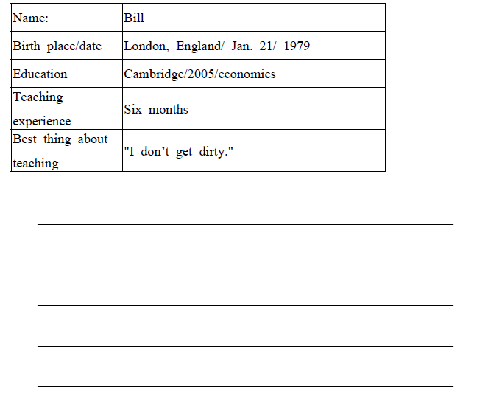
Accuracy-focused Activities

Slide 63
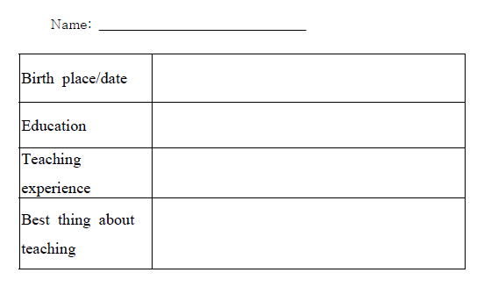
Accuracy-focused Activities
Interview your partner and complete.
Now write a paragraph about your partner. You can refer to the model if you need to.

Slide 64
Accuracy-focused Activities
Sentence combination
1. I met a man. He had seven wives.
_____________________________________________________
2. She took the book. It was in your bag.
_____________________________________________________
3. The girl was young. The girl had blond hair. The girl shouted to
her friend. The girl shouted loudly.
_____________________________________________________

Slide 65
Accuracy-focused Activities
Contextualized sentence combination
Read the sentences about Johnny Appleseed and then combine them to form a single coherent paragraph. The aim here is to produce longer, more complex sentences, using linking words, relative pronouns, and reduced participles. Many different versions are possible.

Slide 66
Accuracy-focused Activities
Use the following sentences to form your own paragraph:
-Johnny Appleseed’s real name was John Chapman.
-He was born in 1774.
-He was born in Massachusetts.
-He traveled westward.
-At that time, he was 23 years old.
-He went to the Ohio River Valley.
-He found no apple orchards.
-He found no apple trees.

Slide 67
Accuracy-focused Activities
Text Conversion
Look at the first paragraph from the following and either:
-Rewrite it in the present tense
-Rewrite it from the point of view of the baby buffalo/giraffe/mother buffalo/lion
-Rewrite it by changing "a lion" to "some lions"
-Rewrite it by supplying adjectives for "water", "baby buffalo", "giraffe", "circle"
-Rewrite it using reported speech

Slide 68
Accuracy-focused Activities
Story:
One hot afternoon in Africa, a lion was walking very slowly through the tall, yellow grass. It was hunting. The lion saw a baby buffalo that was sleeping while its mother drank water at the river. This looked like an easy meal for the lion.
The lion was just about to catch the baby buffalo while it slept, but a tall giraffe saw him and shouted, "Run everyone! There's a lion!“
When the baby buffalo heard this, he screamed, "Mommy, help me!“
The baby buffalo's mother and aunts and uncles came running from the river. They formed a circle around the baby buffalo and pointed their sharp horns toward the lion.
The lion was very hungry, but it knew that it was too dangerous to attack all of the strong buffalo. The lion shouted angrily, "Next time I will bring my family, too!" And then the lion turned around and ran away.

Slide 69
Quick Review
Before we begin, look back over the completed activities from the afternoon session and rate each one as:
1) very useful
2) somewhat useful
3) not so useful
4) not useful
5) impossible
Now, compare with your partner and discuss any modifications that would make them more suitable for your own learners.

Slide 70
Cooperative Writing
Afternoon session

Slide 71
Cooperative Writing
Here are some of the second language learning principles that we should using in our writing classes.
Learner Autonomy: Giving students some choices in the classroom.
Making them feel responsible their own learning and their classmates’ learning.
Cooperative Learning: Students work together to complete a task.
-Teacher chosen groups: It can be beneficial for the teacher to pair or group students.
-Team building: Some ice breaking activity may be required
Group autonomy: There is a feeling of group responsibility, but also diminished burden.
-Simultaneous Interaction: It’s less stressful for students and teachers. All students have a lot of speaking time.
-How do we ensure equal participation and prevent lazy partners?
-Divide the labor between group members but each member must complete the final task -Each student takes a turn to read or speak
-Teacher randomly selects group members to explain their work
-Positive interdependence: Each student feels like a part of the group and has an important role.
-Sit close together

Slide 72
Cooperative Writing
Make group roles such as:
-Dictionary user -Language monitor -Evaluator
-Group representative to read, visit other groups, write on the board
-Keep groups together for more than one class
-Use subjects relevant or interesting to the students.
When groups are too noisy:
1. Assign one member to be the "volume monitor“ 2. Designate a special "group work voice"
3. Use a special signal like the lights or a bell 4. Use Green, Yellow, and Red cards
When groups finish early:
1. Check the group's work 2. Compare with other groups
3. Have groups evaluate their cooperation (L1) 4. Prepare "sponge activities"
5. Set flexible time limits 6. Successful early finishers can split up and help other groups
7. Free study

Slide 73
Cooperative Writing
Dictogloss/Dictocomp
Blackboard Composition
Shared Essay

Slide 74
Grammar Focused Writing

Slide 75
Grammar focused writing
- Structured instructional activity
- Intended to induce learners to pay attention to linguistic form
- Focus on grammatical structure, spelling etc.
- Depends on circumstances and aims

