Slide 1
Interpersonal communication The process of exchanging messages between people whose lives mutually influence one another in unique ways in relation to social and cultural norms. is the process of exchanging messages between people whose lives mutually influence one another in unique ways in relation to social and cultural norms.
1. Functional Aspects of Interpersonal Communication
instrumental goals
You ask your friend to help you move this weekend (gaining/resisting compliance).
relationship-maintenance goals
You post a message on your long-distance friend’s Facebook wall saying you miss him (checking in).
self-presentation goals.
You and your new college roommate stand in your dorm room full of boxes. You let him choose which side of the room he wants and then invite him to eat lunch with you (presenting yourself as friendly).
DTR talk

Slide 2
2. Cultural Aspects of Interpersonal Communication
Relationship cultures
relationship schemata
homo narrans
- storytelling
personal idioms
Jersey Shore
- activities
- labels for others
- requests
- sexual references
GTL
“gym, tan, laundry”
grenade
backpack
GFA
smush
relationship routines

Slide 3
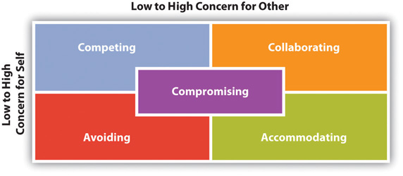
3. Conflict and Interpersonal Communication
Practice:
1. Which conflict management
style, from the five discussed,
would you use in this situation?
2. What are the potential strengths
of using this style?
3. What are the potential
weaknesses of using this style?
Five Styles of Interpersonal Conflict Management
Scenario 2: Neatness. Your college dorm has bunk beds, and your roommate takes a lot of time making his bed (the bottom bunk) each morning. He has told you that he doesn’t want anyone sitting on or sleeping in his bed when he is not in the room. While he is away for the weekend, your friend comes to visit and sits on the bottom bunk bed. You tell him what your roommate said, and you try to fix the bed back before he returns to the dorm. When he returns, he notices that his bed has been disturbed and he confronts you about it.
Scenario 1: Noise and having guests. Your roommate has a job waiting tables and gets home around midnight on Thursday nights. She often brings a couple friends from work home with her. They watch television, listen to music, or play video games and talk and laugh. You have an 8 a.m. class on Friday mornings and are usually asleep when she returns. Last Friday, you talked to her and asked her to keep it down in the future. Tonight, their noise has woken you up and you can’t get back to sleep.
See: Dealing with Conflict pdf online

Slide 4
4. Emotions and Interpersonal Communication
Emotions are physiological, behavioral, and/or communicative reactions to stimuli that are cognitively processed and experienced as emotional.
primary emotions
joy, distress, anger, fear, surprise, and disgust
secondary emotions
love, guilt, shame, embarrassment, pride, envy, and jealousy

Slide 5
- secure
- avoidant
- anxious
*Evolution and Emotions
attachment theory
*Culture and Emotions
social norms
display rules
*Expressing Emotions
emotion sharing
*Managing and Responding to Emotions
emotional intelligence

Slide 6
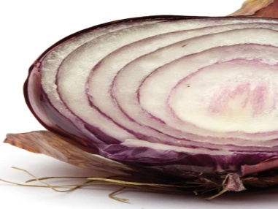
5. Self-Disclosure and Interpersonal Communication
- Social penetration theory
- Social comparison theory
- Johari window
The Process of Self-Disclosure
observations, thoughts, feelings, and needs.
Effects of Disclosure on the Relationship
dispositional attribution
situational attributions
interpersonal attributions

