Slide 1
Writing
2015.01.05~2015.01.23

Slide 2
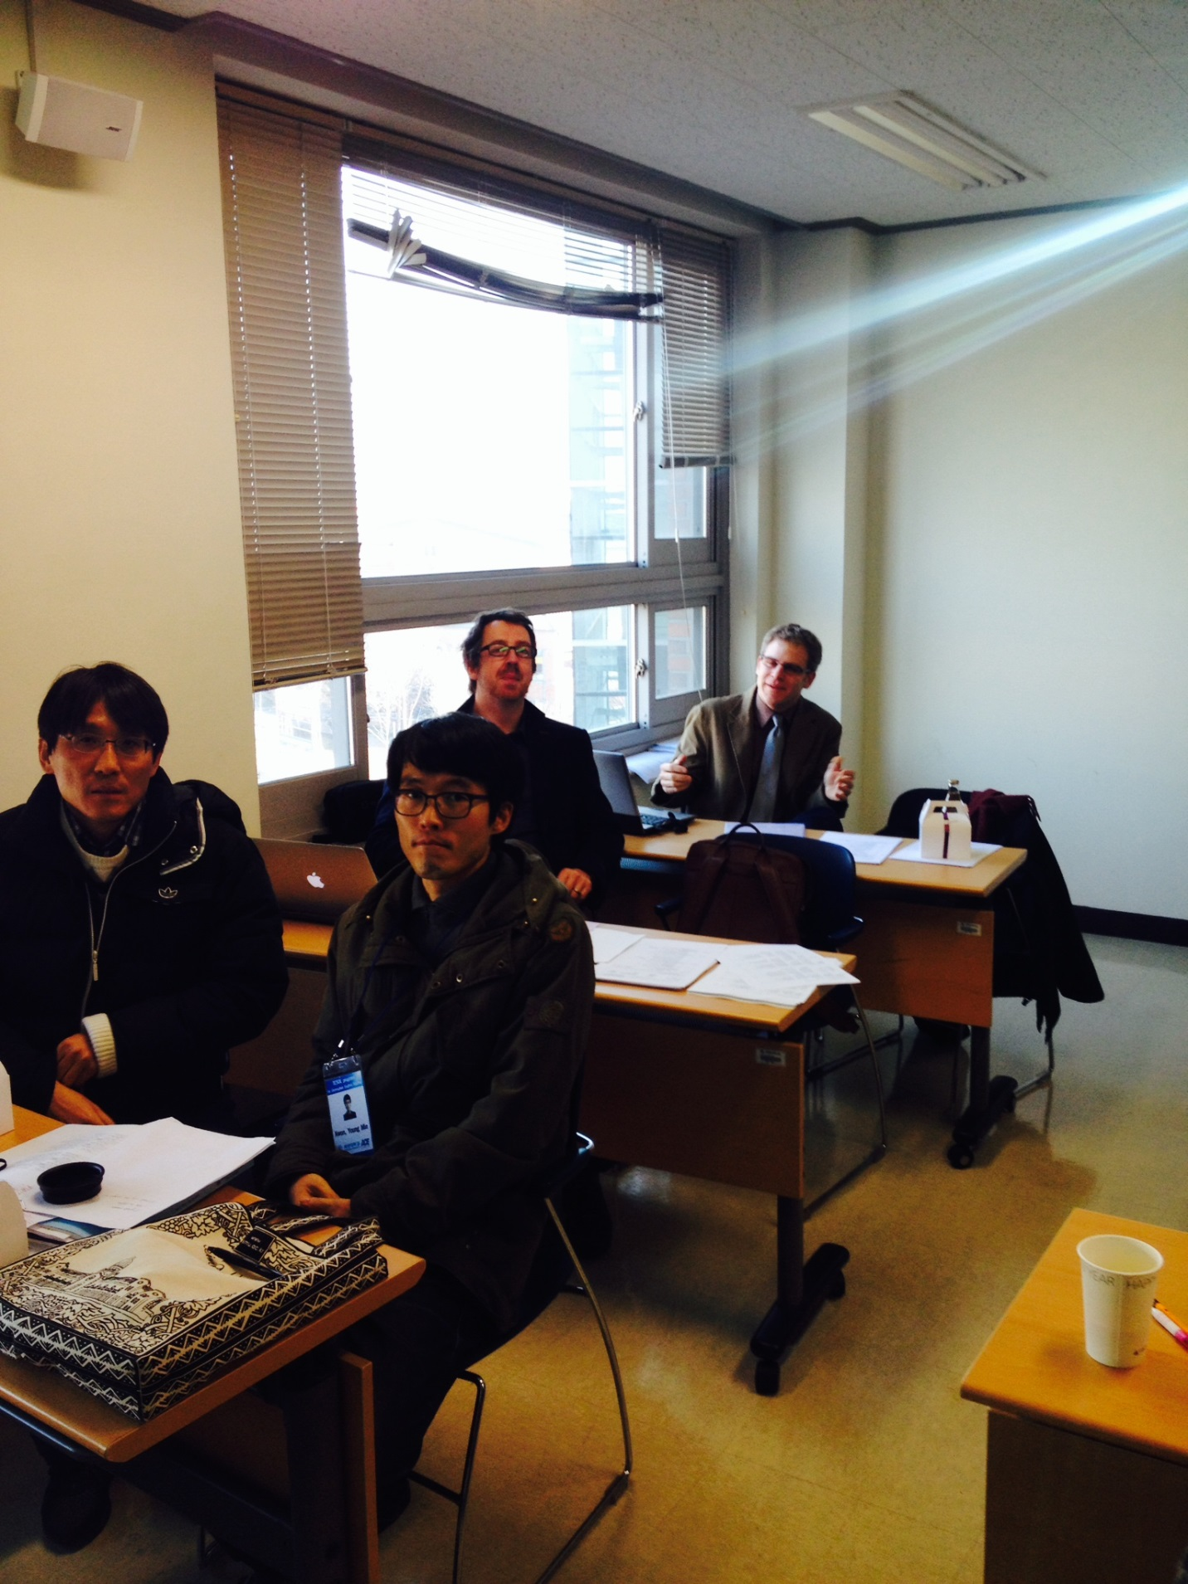
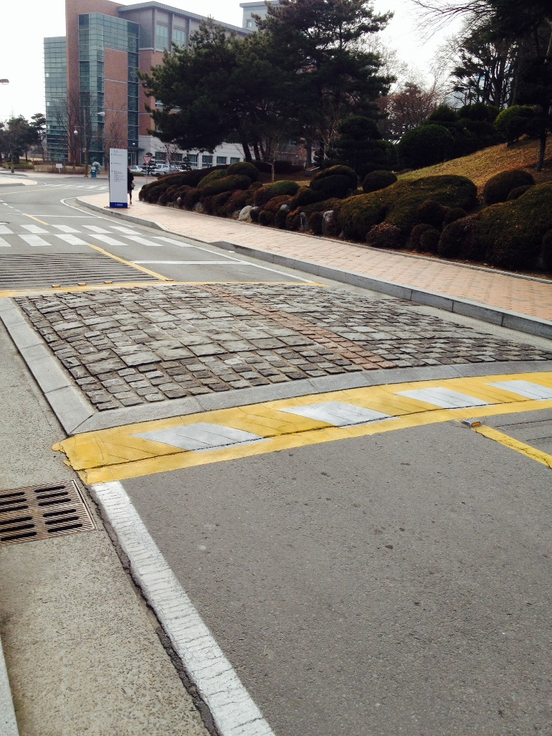

Unforgettable KMU Training

Slide 3
Unforgettable phrase
“Great satisfaction takes good work.”

Slide 4
Unforgettable phrase
“You are the author of your own life.”

Slide 5
Seanan’s Writing Class
Reflection
Daily Homework
Visiting library
Writing tasks

Slide 6
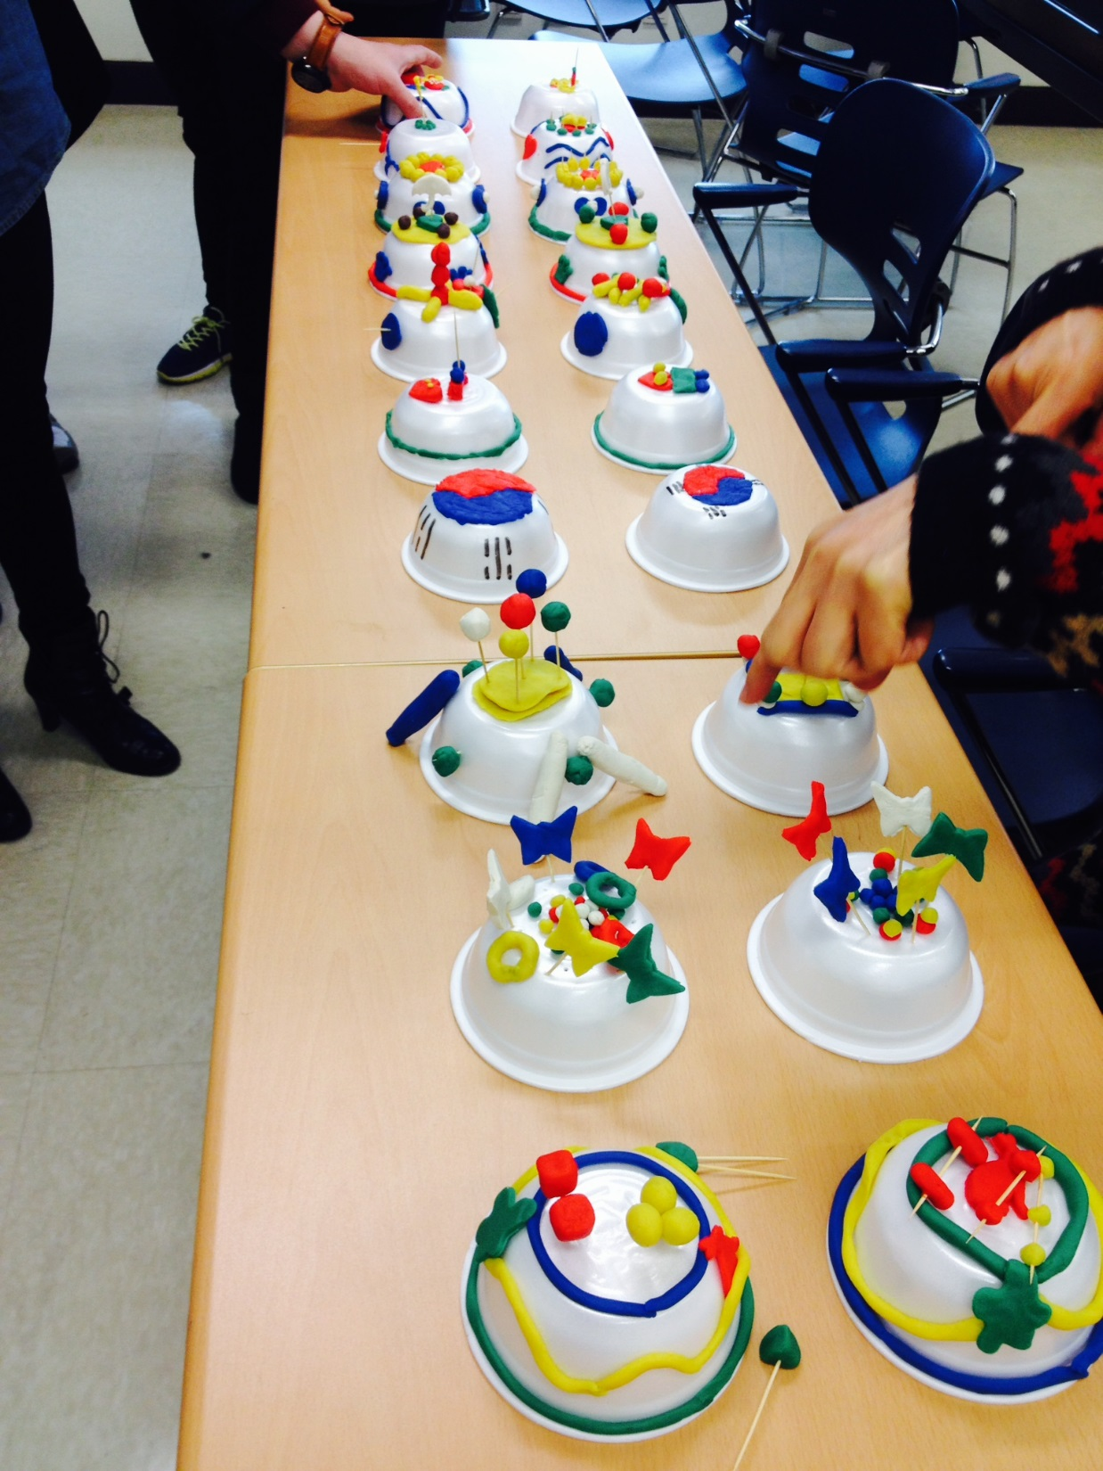
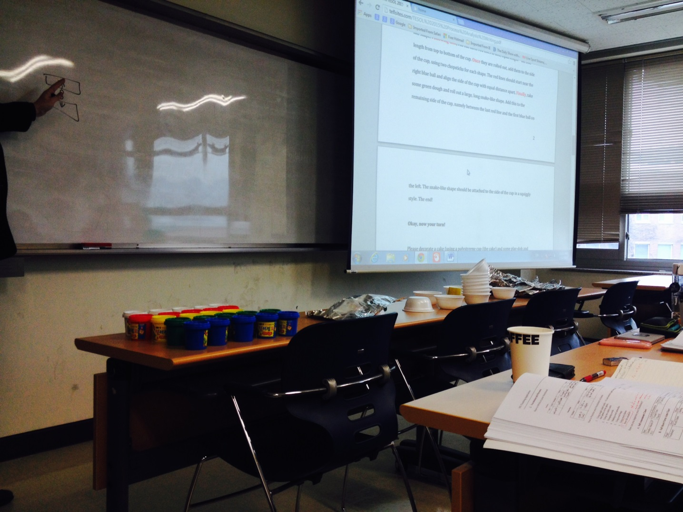
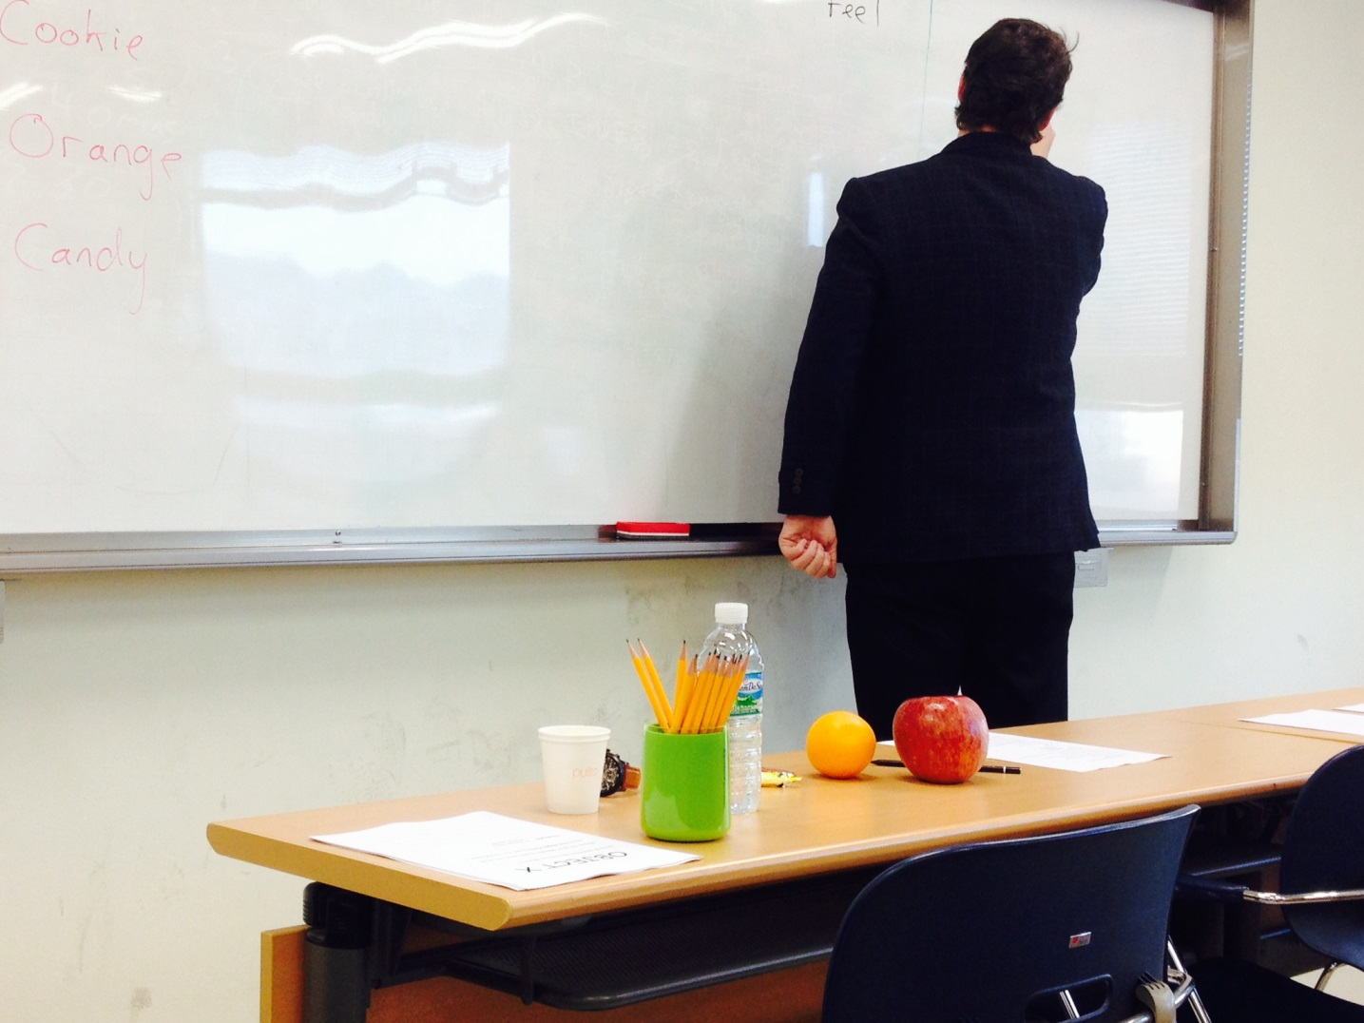
Seanan’s Writing Class
Kim Jeoengmi liked:
“I can guide students’ writing through various activities.”
Lee Wonmin liked:
the writing practice using five sense and adjectives.
(for low lv students)
Reflection Writing
Structural Wr-(Burger)
Descriptive Wr-(subway)
Definition Wr-
Process Analysis Wr-
(Cake Deco)
Opinion Wr-(OREO)

Slide 7
Seanan’s Writing Class
“Grammar correction is teacher’s job. Do not grade their writings based on grammatical errors.”

Slide 8
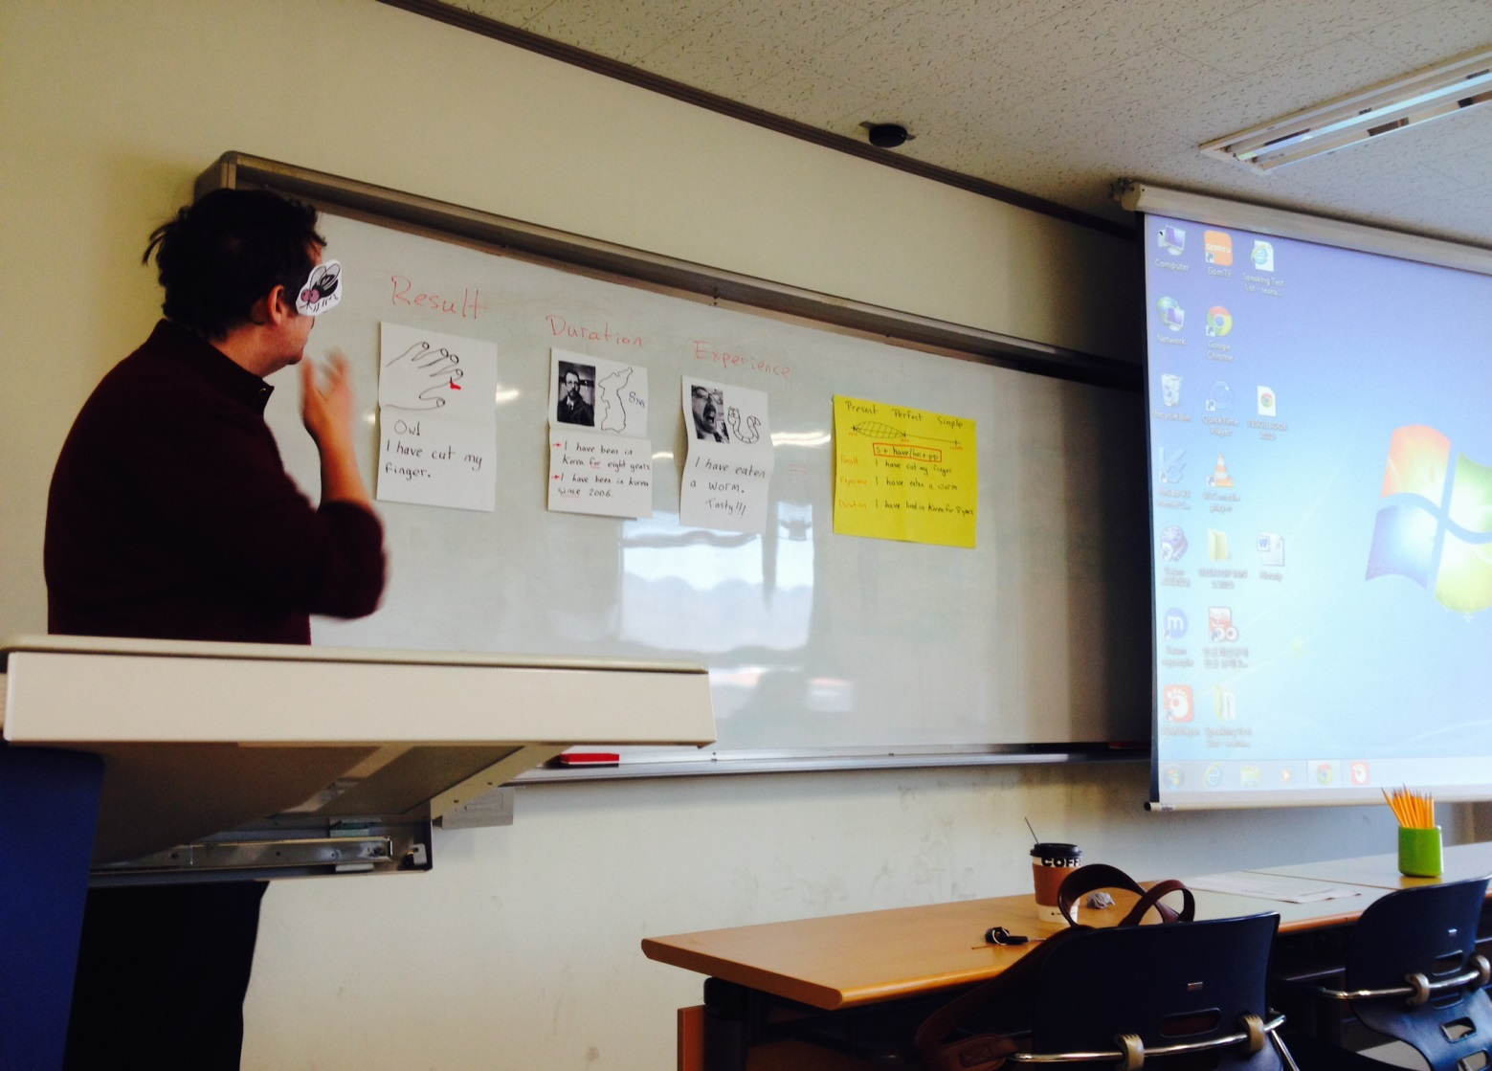
Seanan’s Writing Class
“Is it still on?”

Slide 9
Seanan’s Writing Class
Choi Seongbong liked this demo class.
“I would like to further explain the meaning the prepositions.”
Demonstration

Slide 10
Seanan’s Writing Class
Park Hyunsik liked small games:
“Students could find out something fun within the target language…”
O, T, T, F, F, S, S, __, N, T
R, O, V, G, _, I, V
…

Slide 11
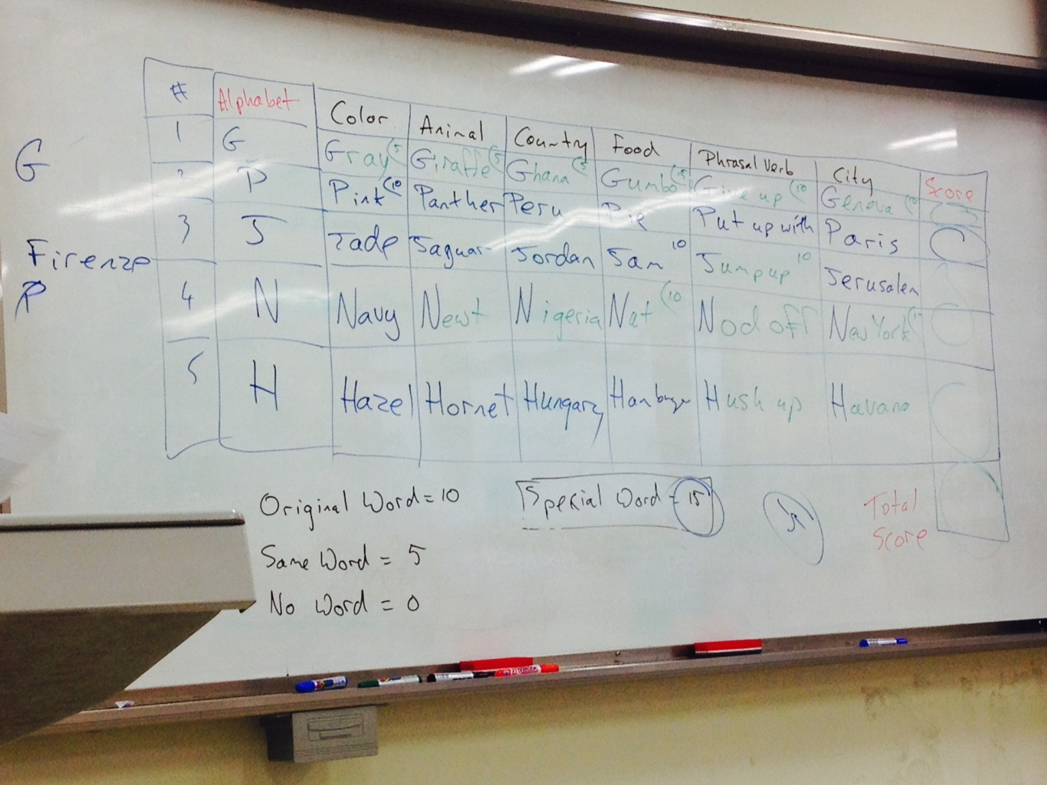
Seanan’s Writing Class
Kim Myungsik liked this game.
“We can find out more games like this from google.”
Fill in the gap

Slide 12
Student comments:
It was not easy for me to follow the class, but I finally made it thanks to the two professors and collegue teachers.
Choi Seongbong
Now I feel I am well equipped to guide my students' writing.
I'll apply skills to my students at least once a month.
Thanks, Seanan!
Kim Jeongmi
Actually, I've thought writing lesson is difficult to the low lv students, but I got competence to the writing lesson after Seanan's introduction to writing activites.
Thanks, Seanan!
Lee Wonmin

Slide 13
Closing
“You don’t have to be perfect, but should be adaptable to get ready to fix whenever needed.”

Slide 14
Closing
“One step, and another step, and another step.. All these steps will make you to the top.”

Slide 15
Thank you!

