Slide 1
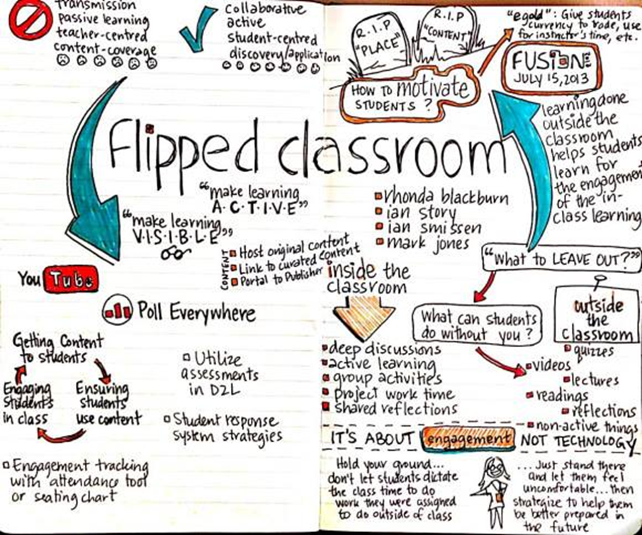
Flipped Learning (Practical Focus)

Slide 2

Flipped Learning (Practical Focus)
What is a flipped class? (a 1 minute video)

Slide 3
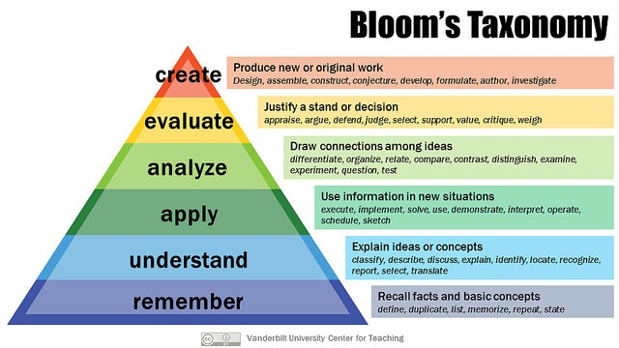
Flipped Learning (Practical Focus)

Slide 4
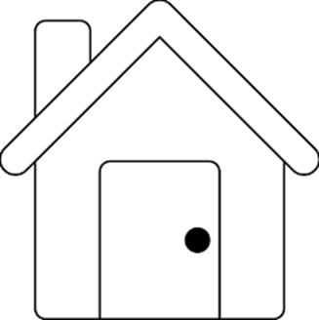



Flipped Learning (Practical Focus)
2. Students –
Before Class
(At Home)
3. Students &
Teacher During Class
1. Teacher
4. Students -After Class
(At Home)
4. Teacher – After Class

Slide 5
Flipped Learning (Practical Focus)
1. Teacher
Use existing technology to ease faculty and students into a flipped mindset
PPT voiceover
Allow yourself time for experimenting with tech tools and methods
ED TED , WSQ , PlayPosit , Edpuzzle , ScreenCast , Youtube Channel ,
Keep video lectures short (10-13 minutes is ideal)
Buddy up with one or more teaching partners / or tech-savvy students
Set a specific target for the flip
Don’t try to do too much at once

Slide 6
Flipped Learning (Practical Focus)
2. Students Before Class (At home)
Clear understanding of what to do in the next class? (bring in worksheet, questions, discussion groups, projects etc…
Videos, reading, introduction to concepts, getting familiar with terms and phrases
Instructions, worksheets, online quizzes…

Slide 7

Flipped Learning (Practical Focus)
3. Students & Teacher During Class
In class time is used for deeper engagement with content, while the teacher provides guidance through:
Collaborative projects
Individual and group problem solving
Peer-based learning activities
The teacher can also:
Clarify points the students did not understand in the video and/or engage students in discussion/interaction about the topic of the video (WSQ)
Differentiate activities and give more one-to-one assistance

Slide 8

Flipped Learning (Practical Focus)
4. Students After Class (At Home)
After class Students can do:
Projects, papers, creative things, review key concepts
They can also:
Assess, discuss, summarize, synthesize, consolidate, evaluate, plan, reflect and prepare for the next class

Slide 9

Flipped Learning (Practical Focus)
4. Teacher After Class
After class Teachers:
Post any additional explanations or resources needed
Grade
Review
Revise
Repeat

Slide 10
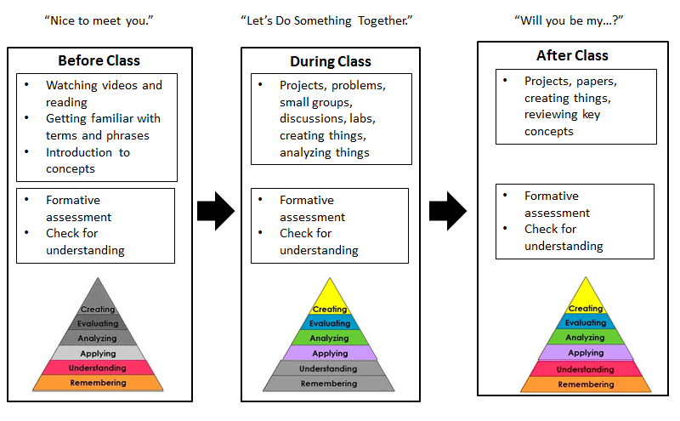
Flipped Learning (Practical Focus)
A quick review…

